Slide 1


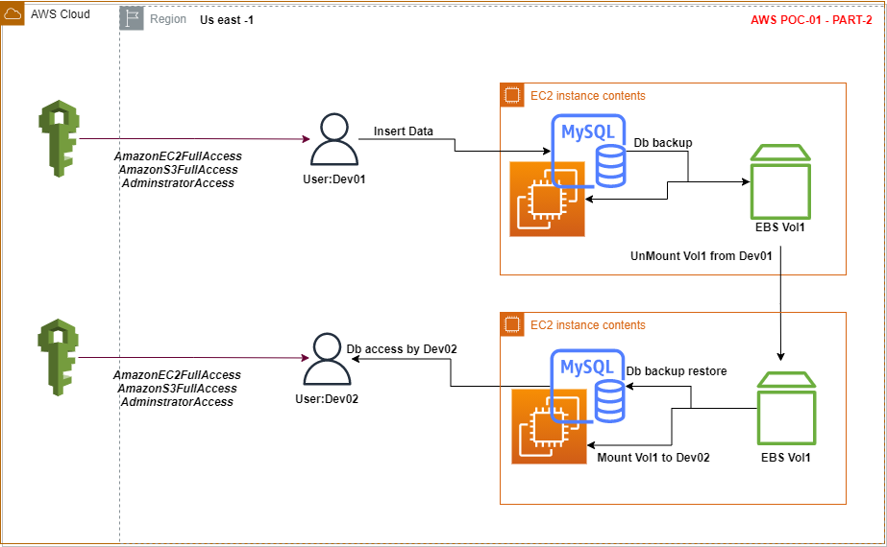


AWS POC-01
PART - 2
A developer needs his Mysql legacy Data setup on EC2 VMs [Linux] and should be shared to other developer through EBS volume
PRAFUL PATEL
AWS CPP, CSAA, Azure Admin
Regina, Canada
www.linkedin.com/in/praful-patel-b24489155
https://github.com/prafulpatel16/prafulpatel16.git

Slide 2
Architectural diagram
Presented By: Praful Patel, Regina, Canada
Presented By: Praful Patel, Regina, Canada

Slide 3
Agenda:
Attach a new EBS volume to Dev01’s EC2 machine.
Take a data backup from user Dev01’s EC2 - Mysql server.
Unmount and detach that new volume from Dev01’s EC2 machine.
Attach that detached EBS volume to Dev02’s EC2 machine.
Mount the data volume
Copy data backup file from new volume to Dev02’s root volume
Restore the database to Dev02’s EC2-Mysql server.
Validate that updated data is displayed into Dev02’s database.
EBS Volume
Attach EBS Volume
Mount EBS Volume
Unmount EBS Volume
Data Backup
Mysqldump
DB restore to fresh database
Db restore
Presented By: Praful Patel, Regina, Canada

Slide 4
Prerequisites:
AWS user’s login - Dev01 and Dev02
AWS EC2 (Linux/ubuntu) Machine with MySQL data setup
EBS Volume with data backup file from Dev01’s account
Presented By: Praful Patel, Regina, Canada
Presented By: Praful Patel, Regina, Canada

Slide 5
Steps:
Dev01’s account - Run a query and Validate that the imported csv data file has all data uploaded into the datatable
Now Insert any sample data to that datatable.
Take a data backup using ‘mysqldump’ and save into the data file into root volume in any folder.
Create a new EBS volume and copy the database backup file from root volume to new volume.
Unmount the new volume from the Dev01’s EC2 linux machine
Login in to Dev02’s account and launch a new EC2 linux machine and install MySQL server.
Mount that EBS volume to Dev02’s machine which is unmounted from Dev01’s machine.
Copy the data backup file from new volume to root volume.
Restore the database backup file to Dev02’s mySQL server
Run a Query and Validate that all updated data is displayed on Dev02’s account in MySQL server.
Presented By: Praful Patel, Regina, Canada
Presented By: Praful Patel, Regina, Canada

Slide 6
Query an existing database from Dev01
Task 1
1.Go to Dev01’s EC2 machine - Connect
2.Login to Mysql server
mysql -u root -p
3.Verify that database is exist
mysql> show database;
4.Use database
Use <databaseName>;
5.Query and existing database and validate that all data is exist in the table from PART-1
Select * from userdetails;
Presented By: Praful Patel, Regina, Canada
Presented By: Praful Patel, Regina, Canada

Slide 7
Insert a new data in to existing database on Dev01
Task 2
#INSERT data into datatable
INSERT INTO userdetails(`id`,`first_name`,`last_name`,`email`,`gender`) VALUES ('1001','praful','patel','praful@gmail.com','male');
#query and check if the data is inserted correctly
Select * from userdetails;
Presented By: Praful Patel, Regina, Canada
Presented By: Praful Patel, Regina, Canada

Slide 8
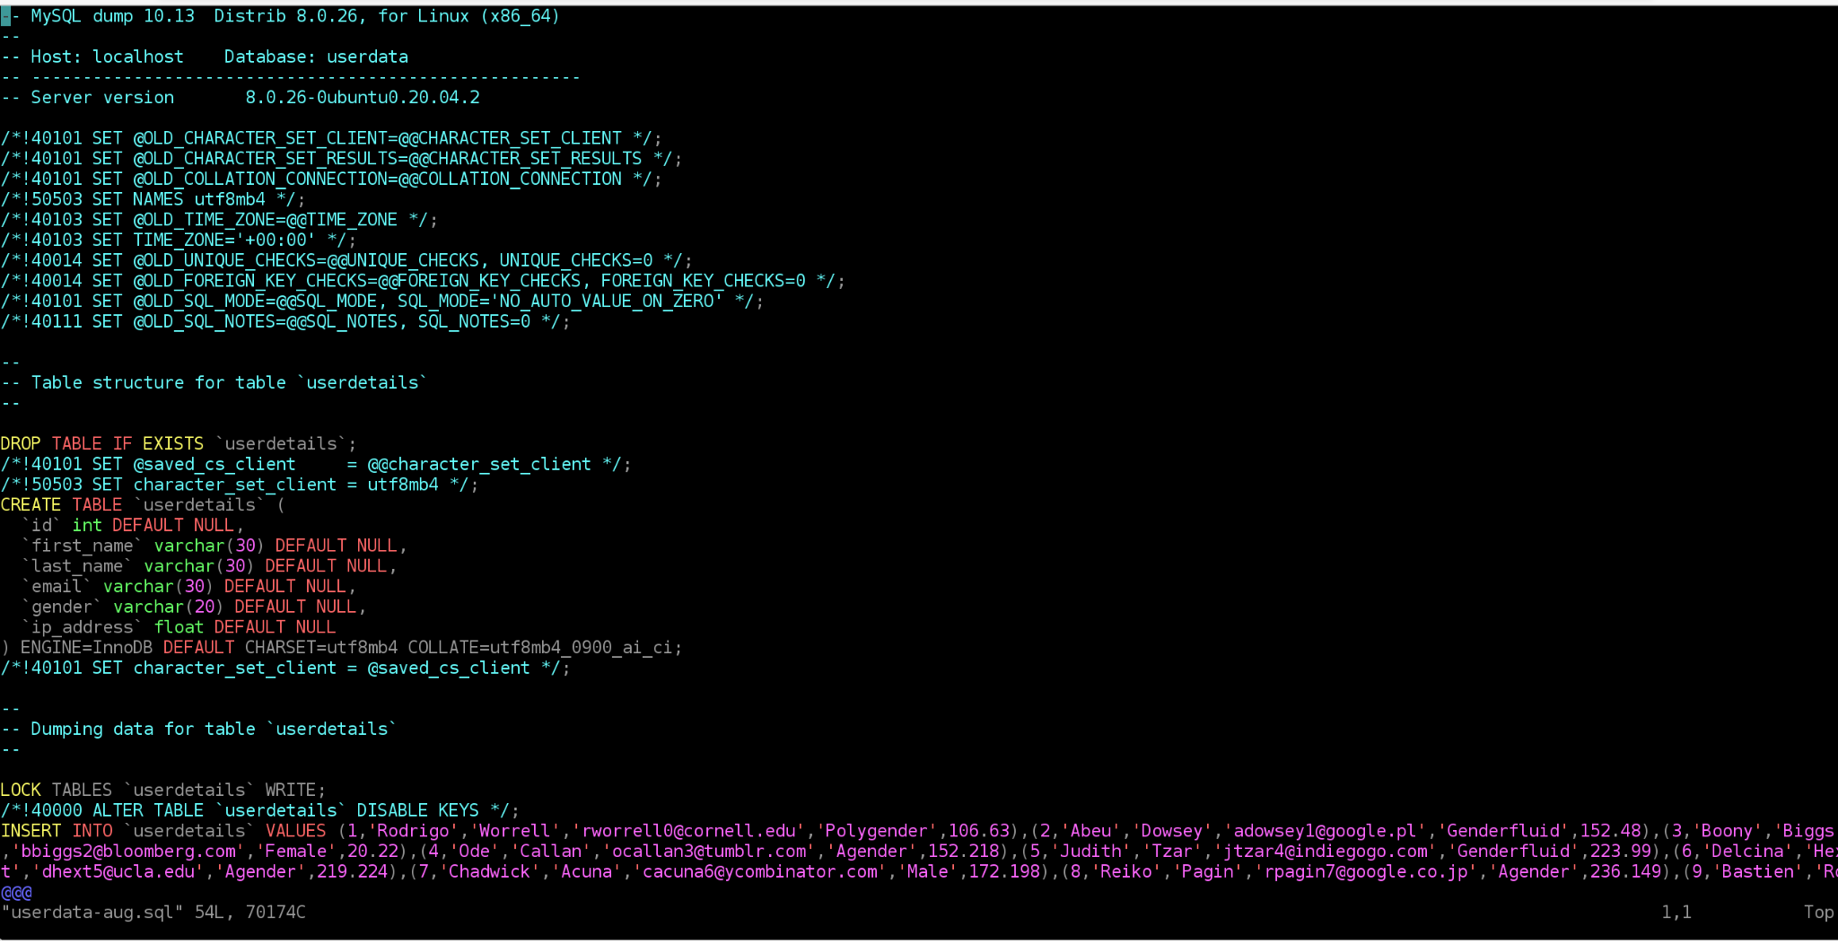
Take a DB backup into root volume from Dev01
Task 3
1.Install mysqldump utility on ubuntu: # sudo apt-get install mysql-client
2.Create a database backup
mysqldump -uroot -p userdata > userdata.sql
3.Verify that the database backup file is created under root volume: # ls
Userdata.sql
4.Verify that data backup is stored in that file: # vi userdata.sql
5.Check the backup file path: #readlink -f userdata.sql
/home/ubuntu/
Presented By: Praful Patel, Regina, Canada
Presented By: Praful Patel, Regina, Canada

Slide 9
Create a second EBS volume on Dev01
Task 4
Go to Dev01’s aws login
Go to EC2 dashboard
Go to Elastic Block Store - Volumes - Create Volume
Volume Type: General Purpose SSD(gp2)
Size: 10GB
Availability Zone: same as EC2 machine
Rest of the values as it is
Click to Create Volume
Presented By: Praful Patel, Regina, Canada
Presented By: Praful Patel, Regina, Canada

Slide 10
Attach EBS Volume
Task 5
Go to Dev01’s aws login
Go to EC2 dashboard
Go to Elastic Block Store - Volumes
a.Select a newly created volume.
b.Click on Top Menu -Actions - Click on attach Volume
c.Enter an EC2 instance id on which volume needs to be attached.
d.Enter a device value for volume: /dev/sdf
e.Click to Attach.
f.Go to EC2 Command prompt and mount the volume.
Presented By: Praful Patel, Regina, Canada
Presented By: Praful Patel, Regina, Canada

Slide 11
Mount EBS Volume on Dev01
Task 6
Go to Dev01’s EC2 dashboard - click to connect
Verify that the newly created volume is attached to EC2 machine: #lsblk
Validate that new volume is displayed:# xvdf 202:80 0 10G 0 disk
Check the file system on that volume if it is present: #sudo file -s /dev/xvdf
/dev/xvdf: data
If no file system is created then it’s display only /data , so need to create a filesystem
Create a file system on the volume: # sudo mkfs -t ext4 /dev/xvdf
Now Create a one directory where the data file can be stored on the volume: #sudo mkdir /mnt/vol1
Mount that directory on the newly partitioned volume: # sudo mount /dev/xvdf /mnt/vol1/
Check if the /mnt/vol1/ directory is mounted on the new volume: #lsblk
xvdf 202:80 0 10G 0 disk /mnt/vol1
Presented By: Praful Patel, Regina, Canada
Presented By: Praful Patel, Regina, Canada

Slide 12
Copy Data backup file from root volume to new volume
Task 7
We have database backup file under root volume path: # /home/ubuntu/userdata.sql
1.Need to copy that file to the newly mounted volume to store the backup safe
#rsync -aSHAX /home/ubuntu/userdata.sql /mnt/vol1/
2.Verify that the file is copied from root volume to newly minted volume: # cd /mnt/vol1
#ls
Userdata.sql
Presented By: Praful Patel, Regina, Canada
Presented By: Praful Patel, Regina, Canada

Slide 13
Unmount EBS volume & Detach
Task 8
Now unmount the volume from Dev01’s EC2 machine: #sudo umount -d /dev/xvdf
Detach Volume from console so that it can be attached to Dev02’s EC2 machine:
Go to Dev01’s EC2 dashboard
Go to Elastic block store - Volumes
Select that newly created volume
Click on Actions - Detach Volume
Presented By: Praful Patel, Regina, Canada
Presented By: Praful Patel, Regina, Canada

Slide 14
Create EC2(Linux/Ubuntu) Machine from Dev02
Task 9
Login to Dev02’s AWS account
Open EC2 service
Launch instance
Choose an AMI Ubuntu Server 20.04 LTS (HVM), SSD ami-0801628222e2e96d6 (64-bit x86) / ami-0994658be3d2178e0 (64-bit Arm) (Free tier eligible)
Select t2.micro (Free tier eligible)
Fill up all configuration details - (Note: Select Subnet in same region as the new EBS volume)
Add storage, default storage 8GB
Add tag Name: MySQL Server
Configure Security Group: Create new security Group: SSH 22
Review and Launch - Launch
Choose Create a new key pair - awskey
Launch Instance
Go to EC2 dashboard and select the running instance and click on connect to access instance for configuration.
Presented By: Praful Patel, Regina, Canada

Slide 15
Attach EBS Volume
Task 10
Ensure that you are in Dev02’s aws login
Go to EC2 dashboard
Go to Elastic Block Store - Volumes
Select that volume which detach from Dev01’s EC2 machine.
Click on Top Menu -Actions - Click on attach Volume
Enter an EC2 instance id on which volume needs to be attached.
Enter a device value for volume: /dev/sdf
Click to Attach.
Go to EC2 Command prompt and mount the volume.
Presented By: Praful Patel, Regina, Canada

Slide 16
Mount EBS Volume
Task 11
Ensure that you are in Dev02’s EC2 dashboard - click to connect
Verify that the newly attached volume is displayed to Dev02’s EC2 machine: #lsblk
Validate that new volume is displayed:# xvdf 202:80 0 10G 0 disk
Check the file system on that volume if it is present: #sudo file -s /dev/xvdf
If file system is created then it will display like below, and no need to create a file system
/dev/xvdf1: Linux rev 1.0 ext4 filesystem data, UUID=5866667e-914b-41fa-bc6c-836db0c9725f, volume name "cloudimg-rootfs" (needs journal recovery) (extents) (large files) (huge files)
Now Create a same mount point and directory as created from Dev01’s machine where the data file was stored on the volume: #sudo mkdir /mnt/vol1
Mount that directory on the volume: # sudo mount /dev/xvdf /mnt/vol1/
Check if the /mnt/vol1/ directory is mounted on the new volume: #lsblk
xvdf 202:80 0 10G 0 disk /mnt/vol1
Presented By: Praful Patel, Regina, Canada
Presented By: Praful Patel, Regina, Canada

Slide 17
Copy Data backup file from new volume to Dev02’s root volume
Taks 12
1.Verify that the data backup file is present under newly mounted volume: #cd /mnt/vol1/
#ls
userdata.sql
2.We have database backup file under new volume path: # /mnt/vol1/userdata.sql
3.Now Need to copy that file to the root volume to restore
#rsync -aSHAX /mnt/vol1/userdata.sql /home/ubuntu/
4.Verify that the file is copied from new volume to root volume under path: # /home/ubuntu/
#ls
Userdata.sql
Presented By: Praful Patel, Regina, Canada

Slide 18
Install MySQL Server on EC2
Task 13
1.Apply the following commands:
#sudo apt update
#sudo apt-get install mysql-server
2.To check the installed version of MySQL: #mysql --version
3.To install mysql secureway: #sudo mysql_secure_installation
4.To check mysql service is running: # sudo systemctl status mysql.service
5.To get into mysql: #sudo mysql
Presented By: Praful Patel, Regina, Canada

Slide 19
Install MySQL Server on EC2 Continue...
Task 14
1.To check authentication method for mysql user
#mysql> select user, authentication_string, plugin, host from mysql.user;
2.To provide security to the user
#mysql> ALTER USER ‘root’@’localhost’ IDENTIFIED WITH caching_sha2_password by ‘mypassword’;
3.To login from the root account
#mysql -u root -p
Presented By: Praful Patel, Regina, Canada

Slide 20
Create database in Dev02’s MySQL server
Task 15
1.List databases: mysql> Show databases;
2.Create a database: mysql> create database userdata;
3.To use database: mysql> use userdata;
4.Check database is created:
mysql> show databases;
userdata
Next - Restore the data backup file to this database
Presented By: Praful Patel, Regina, Canada

Slide 21
Restore DB backup to Dev02’s mysql server
Task 16
1.Verify that the same database is created:
2.Login to Mysql: # mysql -u root -p
mysql> show databases;
Userdata
3.Quit from database: mysql> quit
4.From the command prompt restore the database: # sudo mysql -uroot -p userdata < userdata.sql
Presented By: Praful Patel, Regina, Canada

Slide 22
Verify that updated record is present on restored database
1.Verify that the data is successfully restored into mysql database:
mysql> use userdata;
Select * from userdata;
2.Verify that inserted data from Dev01 is also present in this Dev02’s database
Show tables;
3.Query database to show the records:
Select * from userdetails;
Presented By: Praful Patel, Regina, Canada

Slide 23
Thank you
PRAFUL PATEL
AWS CPP, CSAA, Azure Admin
Regina, Canada
https://github.com/prafulpatel16/prafulpatel16.git
www.linkedin.com/in/praful-patel-b24489155

Slide 24
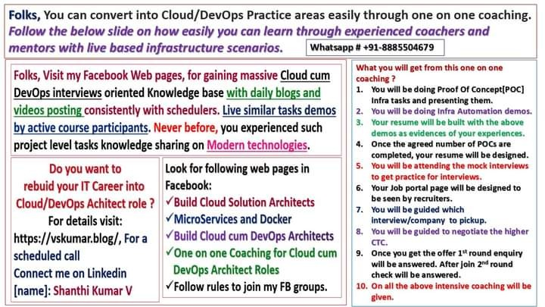
Coached by: Shanthi Kumar V

